Slide 1


Wearable Perspiration Profiling System (PPS)
AY 2021-25
GITAM UNIVERSITY
Major Project
Project ID: V6
A University should be a place of light, of liberty, and of learning.
Department of Electrical Electronics and Communication Engineering
Project Team:
Vadde Poorna Chandra
P. R. Poojitha Reddy
P. Sindhu
Project Mentor:
Dr. Lignesh B Durai
www.gitamedu.com

Slide 2

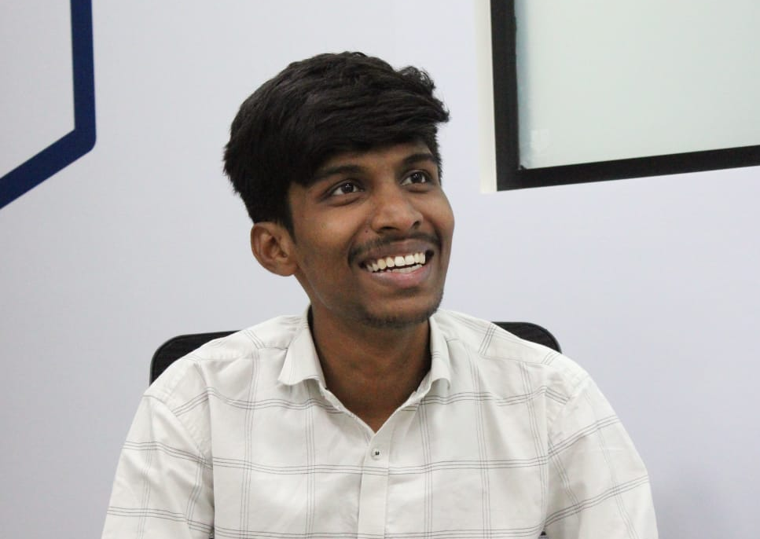

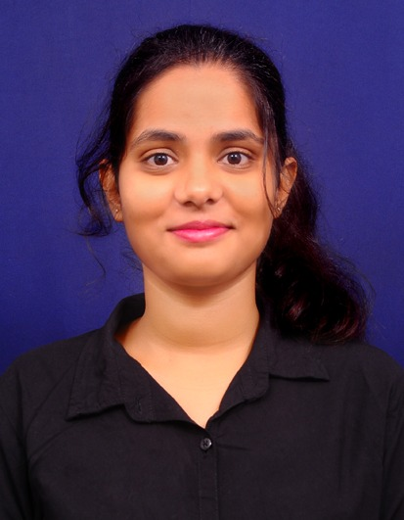
Project Group – Details
Photo
Track
Roll No
Name
EECE AI/ML
BU21EECE0100094
Vadde Poorna Chandra
EECE AI/ML
BU21EECE0100587
P. R. Poojitha Reddy
EECE AI/ML
BU21EECE0100479
P. Sindhu

Slide 3
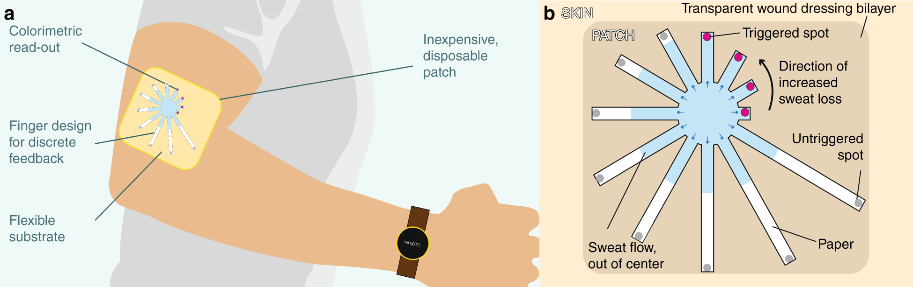
Objective and Goals
Objective
To develop a scalable, non-invasive, and cost-effective diagnostic platform for Alzheimer's disease (AD).
To Develop sweat-based biomarker detection patch integrated with colorimetry and a mobile application.
Expected Outcome
Development of the Wearable Patch
Synthesis of nanomaterials
Analyse of concentration of particular substance
Smartphone Integration

Slide 4
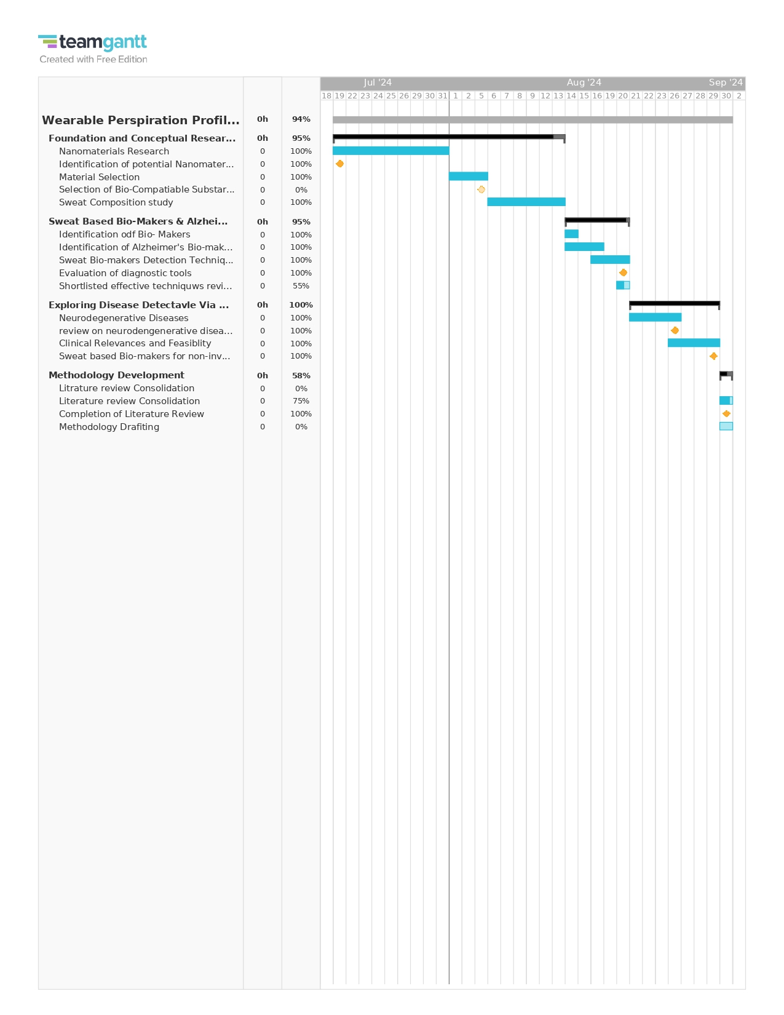
Project Plan

Slide 5
Literature Survey
Key Publications
Title | Article Links
Recent Developments in Sweat Analysis and Its Applications | https://www.ncbi.nlm.nih.gov/pmc/articles/PMC4369929/
A review of wearable biosensors for sweat analysis . | https://link.springer.com/article/10.1007/s13534-021-00191-y
Contribution of Alzheimer disease to mortality in the United States | https://www.ncbi.nlm.nih.gov/pmc/articles/PMC3962992/#:~:text=Seventy%2Dtwo%20percent%20of%20those,related%20to%20age%20at%20diagnosis
Recent developments in Alzheimer's disease therapeutics | https://www.ncbi.nlm.nih.gov/pmc/articles/PMC2649159/
Recent Advances in Wearable Sensors for the Monitoring of Sweat: A Comprehensive Tendency Summary | https://www.mdpi.com/2227-9040/11/9/470

Slide 6
Analysis - SWOT
Strengths
Weaknesses
S1. Innovative use of nanotechnology and biocompatible materials
S2. High sensitivity for early Alzheimer’s detection.
S3. Non-invasive and real-time monitoring.
S4. Easy to access for everyone
S5. Cost-effective
W1. Enzyme stability
W2. Complex regulatory requirements for approval.
Threats
Opportunities
T1. Competition from Bio-tech companies
T2. Rapid technology advancements leading obsolescence.
O1. Expansion to neurodegenerative disorders.
O2. Integration to health monitoring eco-system
O3. Growing market demand for Non-invasive and cost-effective diagnostics.

Slide 7
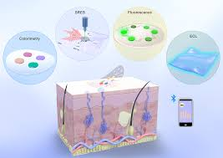
Analysis – 4W1H
Why: Address the unmet need for early, non-invasive Alzheimer’s diagnostics.
What: Develop a Bio-compactable wearable patch leveraging nanomaterials.
Where: Point where diagnosis for early stage detection of AD.
When: Target early-stage Alzheimer’s for timely intervention
How: Utilize sweat analysis through sweat-based colorimetric detection, integrated with smartphone technology.
Refined Objective: To create a robust, scalable diagnostic platform for Alzheimer’s that is accessible in resource-limited settings.

Slide 8
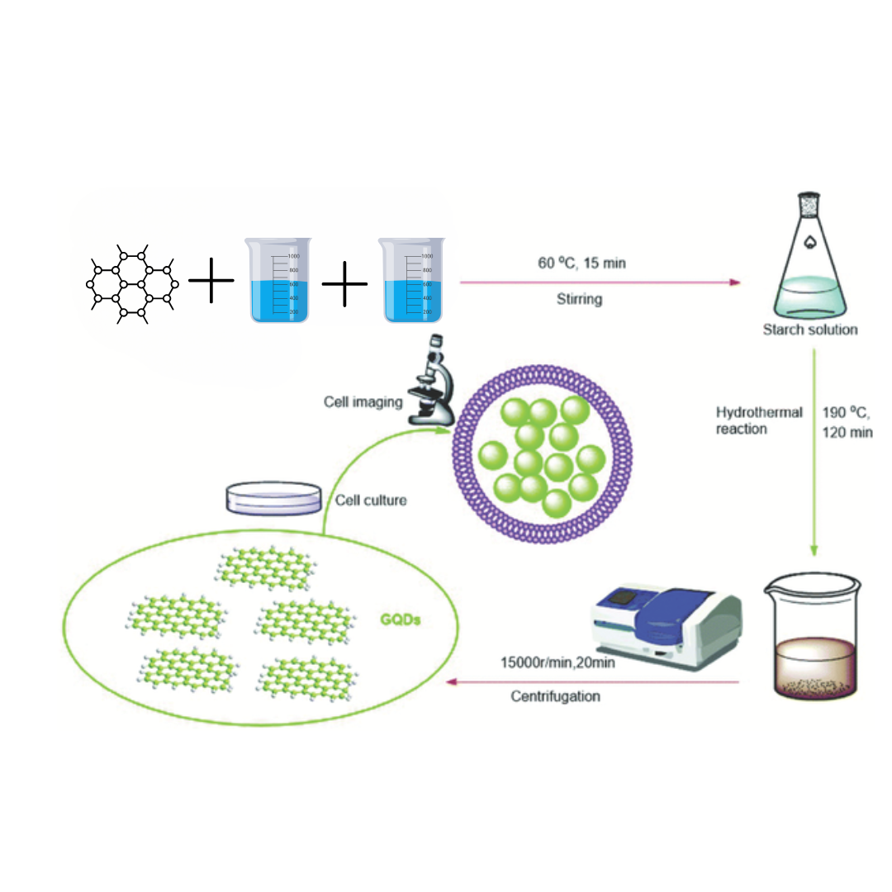
.
Architecture
Synthesis Process of GQDs
GQDs synthesized from 0.30 g pitch carbon fibers.
Carbon fibers oxidized in 60 mL sulfuric acid and 20 mL nitric acid..
Oxidation breaks fibers into smaller graphene fragments.
Mixture sonicated for 2 hours to facilitate breakdown.
Stirred for 24 hours at 80°C, 100°C, and 120°C to control size.
Cooled solution diluted with 800 mL deionized water and neutralized to pH 8.
Dialyzed for 3 days to purify GQDs, removing contaminants

Slide 9
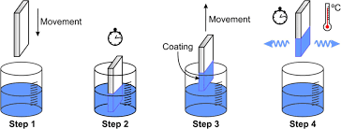
.
Architecture
Fabricating GQD-Enhanced Biomarker Detection Patches
1. Select a paper substrate for GQDs.
2. Clean the paper to improve adhesion.
3. Prepare a GQD dispersion in water.
4. Dip the paper into the GQD solution.
5. Air dry the coated patch completely.
6. Functionalize the patch for sweat biomarkers.
7. Inspect the patch for uniformity and adherence.

Slide 10
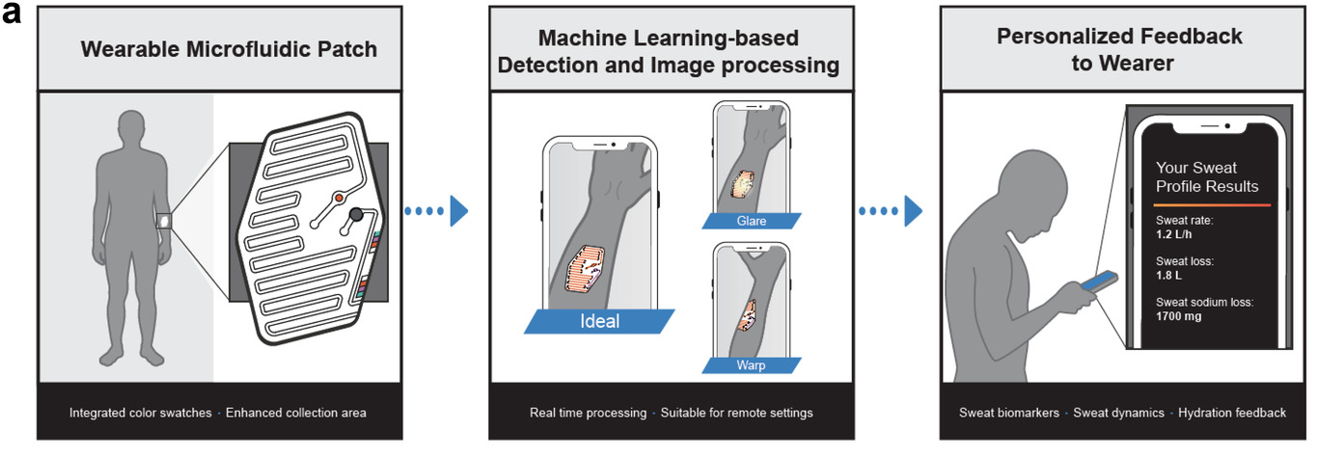
.
Architecture
Colorimetric Detection& Mobile Application
1. Sweat biomarkers cause GQD color changes.
2. Color shifts indicate biomarker presence.
3. Optical sensors effectively detect these changes.
4. Smartphone cameras capture color transformations.
5. The app processes colorimetric data.
6. It delivers real-time biomarker feedback.
7. Users gain insights for informed health decisions.

Slide 11
Use Cases & Testing
Use Cases
Xx
Xx
X
X
Test Cases
XX
XX
XX

Slide 12
Implementation and Results – Iteration 1
Iteration 1 : Results

Slide 13
Implementation and Results – Iteration 2
Iteration : Results + Validation against the usecases and test cases

Slide 14
Implementation and Results – Iteration 3 (Optional)
Iteration : Results + Validation against the usecases and test cases

Slide 15
Contribution
Team Progress and Movement
Initial Planning and Research
Design Phase
Synthesis and Coating of GQDs
Testing and Validation
Mobile Application Development
Individual Contribution
Key contributions: Poojitha Reddy
Synthesized GQDs, optimizing oxidation for quality.
Developed uniform coating methodology for substrates.
Key contributions: Sindhu P
Designed experiments to assess biomarker interactions.
Formulated testing protocols for accurate results.
Key contributions: Poorna Chandra
Managed data collection and organization phases.
Collaborated on the final presentation preparation.

Slide 16
Conclusion & Future Work
Summary and Conclusion
Future Work

Slide 17

THANK YOU

